Slide 1
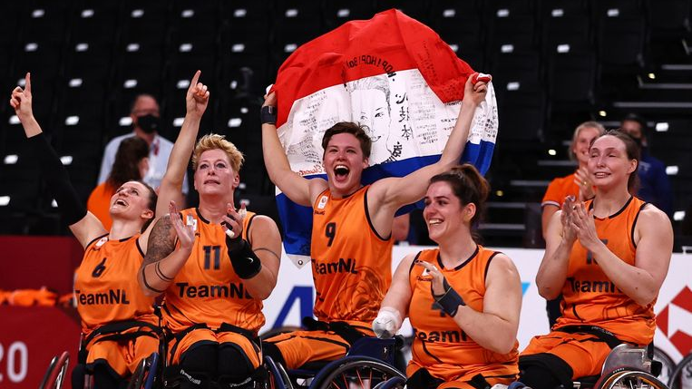
Internal presentation 22 nov
By wheels

Slide 2
Lat presentation
fixing dataset (manually -> two models with good recall comparing)
(this way we made a fully working model for the sprints)
Finetuning models
Sprinting definition
(we have a model that detects sprints)

Slide 3
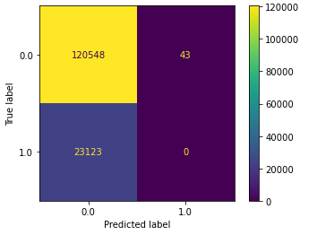
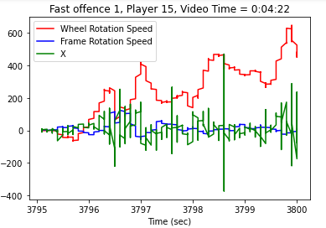
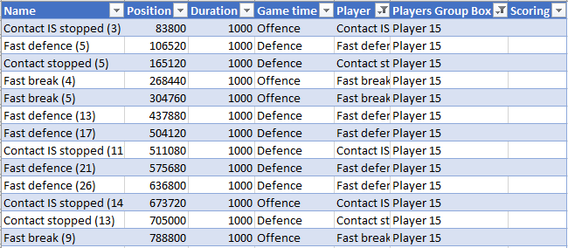
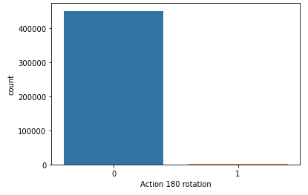
This sprint (models we are working on)
Confusion matrix player15 rotations
Random forest classifier (rotations)
Random forest classifier (collisions)
Rotations action count (based on 0.01 secs)
0: 451761
1: 1250
Notes:
RFC (rotations). No definition of a rotation yet.
Looking at the video with the data and finding good examples.
Setting those examples. [and counting them]
Try balancing(got 4000 examples by just copying and pasting)
Not working….
RFC(collisions). Also no definition yet. Timestamps weren’t correct.
Fixed the time do that the events could be checked in the graph.
Point into decision tree didn’t work. Now trying random forest generator.

Slide 4
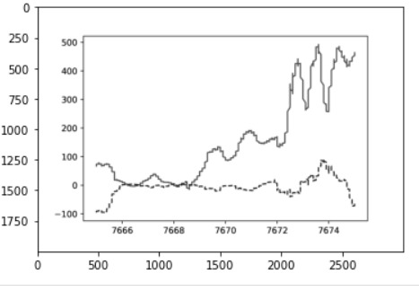
This sprint (models we are working on)
2d neural network with images
Making a csv out of the pictures
CSV File
Notes:
First tried to make a 3d datset, but it would make more sense to change it into graphs and use images.

Slide 5
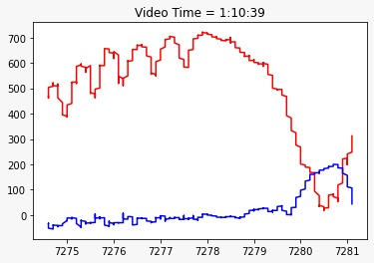
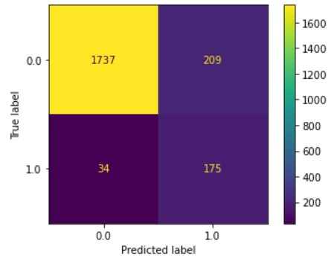
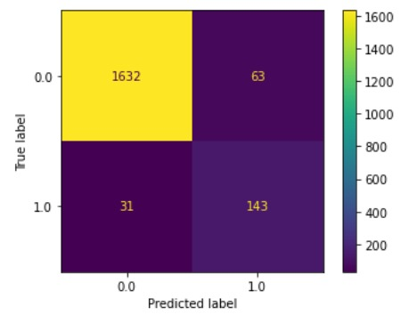
Working sprint model
Random forest classifier vs rnn
Player 15 (from test set to train set)
Player 8 (test set)
Confusion matrix player 15 sprint
Confusion matrix player 15 sprint
RFC
Notes:
Random forest vs rnn
With the help of player 15 we tried to optimize the dataset by using these models. [show confusion maxtrix and explain it.]
We ran both models and compared false positives. (so for this matrix we had 63) if both matrixes have a false positive at the same timeline.
It’s likely this is a sprint. With this more complete dataset we used player 15 as a training set and ran the model [RFC] on a new player.
Player 8.
From this player everything is unknown. So we checked the outcomes with the video and graphs like this one.

Slide 6
What we are going to do
Finishing up the rotations and the collisions by using techniques for sprints
Keep working the 2d neural network by finishing up the cv file.

